Slide 1
BP and Applications
Fall 2020 Ariel University

Slide 2
Applications of Backprop in FF NN
Today
A quick word or two on Backpropagation: A
Example of Non-linear Separated Trained via Backprop (review)
NetTalk: A revolutionary application – showed non-trivial applications possible TEXT-to Speech
Glovetalk: Divide and Conquer Hand Language to Speech
Zipcodes Handwriting Application. Forerunner of Modern Architectures –such as convolutional networks. Follows on Fukishuma Neocognition ; Modern Vision follows on ideas here.

Slide 3
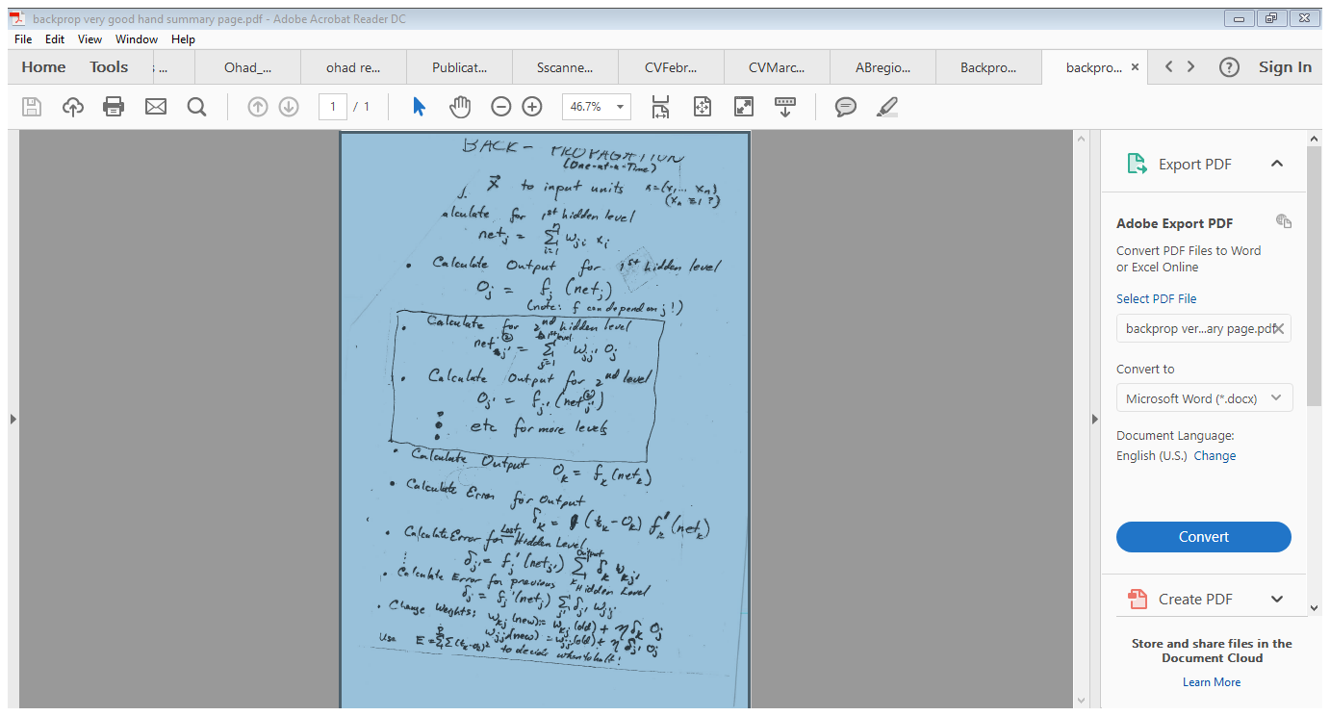

Slide 4
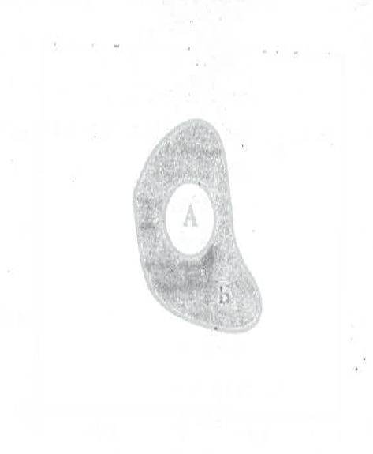

Slide 5
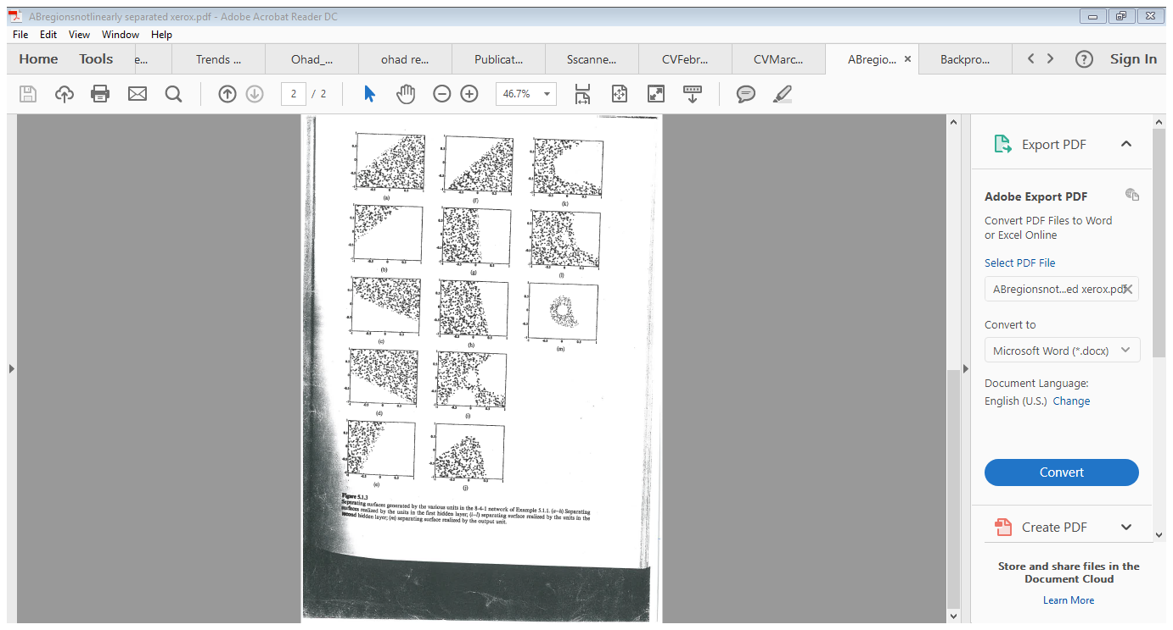

Slide 9
NETTalk (Sejnowski – Rosenberg)
Text – to – Phoneme (to speech)
3 Level NN. Used 7 (x 29) letter sliding window, 80 hidden units and 26 unit encoding of phoneme.
Trained on 1000 words from dictionary
Trained on informal continuous speech (1000 words)
Reached 95% accuracy; 78% generalizability on continuous speech
Go to Tape

Slide 10
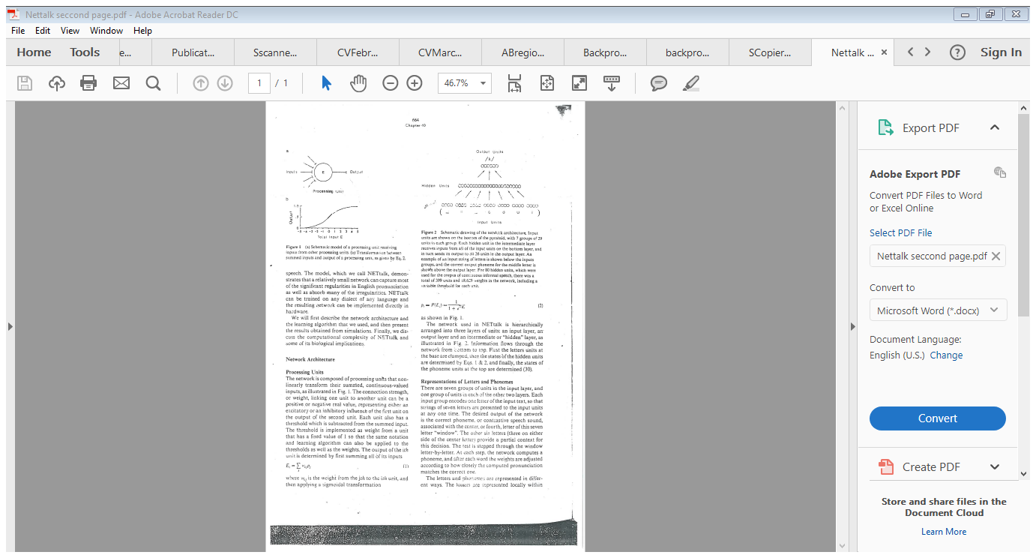
NETTALK

Slide 11
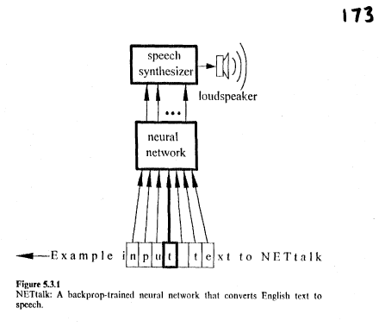

NETTalk
https://www.youtube.com/watch?v=gakJlr3GecE

Slide 12
Reading ZipCodes (LeCunn)
Trained Network to Identify Handwritten Zipcodes for US Postal Service
Very “engineered” modular network
Go to Slide

Slide 13
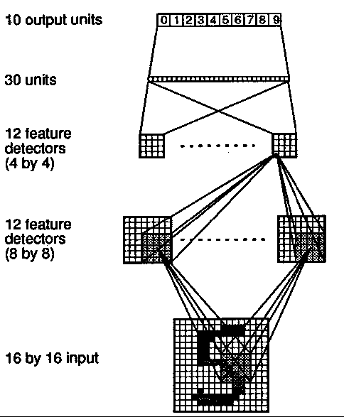
Reading ZipCodes (LeCunn)
Trained Network to Identify Handwritten Zipcodes for US Postal Service
Very “engineered” modular network
Go to Slide

Slide 15
Prediction
PLANT
Input
Compare
delay
NN

Slide 16
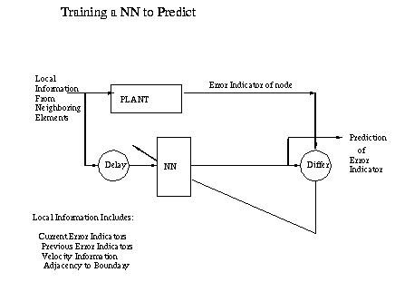
Training NN to Predict

